Slide 1




A Project Based Learning Presentation on
A.Q.W.A.P.O.D.
ANALYSIS OF QUALITY OF WATER AND PREDICTION OF DISEASES
By:
3025 - PRATIK LIMBEKAR
3029 - GAURI KHARAD
3036 - HIYA SHAH
3038 - POORVA JADHAV
Under the guidance of Prof. Anil M. Bhadgale for the A.Y. 2024-25.
Department of Computer Engg., PVGCOET, Pune

Slide 2


PROJECT DETAILS
PROJECT TITLE: AQWAPOD - ANALYSIS OF QUALITY OF WATER AND PREDICTION OF DISEASES.
PROJECT GROUP NUMBER: 10
GROUP MEMBERS:
3025 - PRATIK LIMBEKAR
3029 - GAURI KHARAD
3036 - HIYA SHAH
3038 - POORVA JADHAV

Slide 3


PROBLEM STATEMENT
Analyze quality of water using input parameters such as pH and location, leveraging datasets and a Machine Learning model to detect anomalies. Indicate potential health risks and water potability, reducing the need for manual testing and helping prevent waterborne diseases.

Slide 4
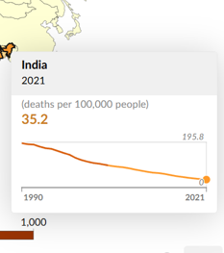
MOTIVATION
Access to clean, safe water is a fundamental human right, yet many communities face challenges due to inefficient and infrequent water testing.
Contaminated water results in health crises, waterborne diseases, and lack of awareness. Driven by these issues, we aim to harness technology and innovation to ensure safer water for all
Figure 1 (Reference 4)

Slide 5
AIM
Develop software for quick and accurate water quality testing.
Allow users to input parameters like pH and turbidity.
Use machine learning to analyze data, detect contamination, and assess safety.
Provide early detection to reduce waterborne diseases, especially in underserved areas

Slide 6
OBJECTIVES
Ensure Safe Drinking Water -
Develop a software solution that can quickly analyze water quality parameters like pH, turbidity, and contaminants to determine water potability.
Reduce Risk of Waterborne Diseases -
Use machine learning to identify contamination early, minimizing health risks associated with unsafe water consumption.
Encourage Preventive Measures -
Enable early detection of water quality problems to prevent larger issues and ensure long-term health and safety.

Slide 7
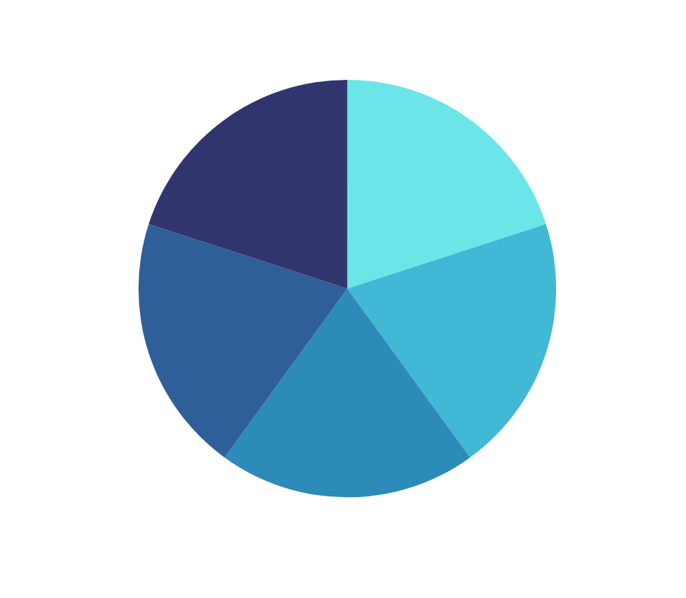
AQWAPOD
DATASETS
MACHINE LEARNING
PARAMETERS
INPUT
ANALYSIS
PREDICT

Slide 8

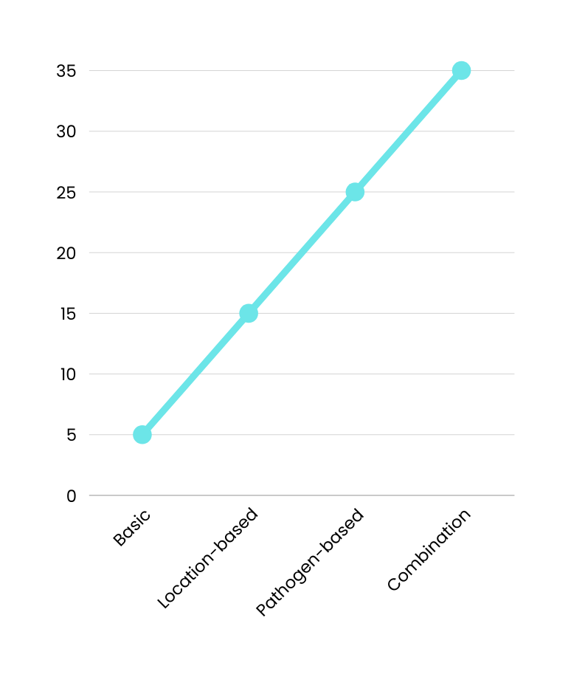

Methods and Process
2 Methods:
Entropy Weighing Method
Pearson Coefficient
The model will predict potability of water and possible pathogens present in it based on the data available/given to it.

Slide 9
OUTCOMES
By completing this project, we will be able to analyse the quality of water using parameters like pH, turbidity etc.
We will gain proficiency in data analysis, machine learning and problem-solving.
We will gain experience in working as a team to tackle real-world problems.
By completing this project, we will be able to analyse the quality of water using parameters like pH, turbidity etc.
We will gain experience in working as a team to tackle real-world problems. This will help in future team activities and projects.

Slide 10
ADVANTAGES
Timely Detection: Provides real-time insights into water contamination, reducing delays associated with manual testing.
Health Improvement: Reduces the risk of waterborne diseases by identifying contamination early.
Cost-Effective: Minimizes the need for frequent manual testing, lowering operational costs.
Data-Driven Decisions: Leverages machine learning to analyze data and provide actionable insights.
Scalability: Can be implemented across multiple rural locations for widespread impact.
Ease of Use: Simplifies monitoring by automating the analysis process and presenting results.

Slide 11
APPLICATIONS
Rural Water Monitoring: Ensures safe drinking water in underserved areas by detecting contamination.
Public Health: Assists in identifying and mitigating waterborne disease outbreaks.
Government Programs: Enhances the efficiency of water safety initiatives and public health monitoring.
Environmental Studies: Helps researchers study the impact of pollutants on water quality.
Educational Tools: Used for training and awareness about water quality management.

Slide 12
CONCLUSION
In this PBL, we will study the application of machine learning to monitor water quality and address the issue of contamination in rural areas. This study aims to explore how machine learning models can analyze parameters like pH and location to detect anomalies and predict health risks, thereby reducing the dependency on manual testing and improving public health outcomes. This work is to demonstrate how data-driven analysis can be utilized to solve real-world problems. This work will be useful in ensuring safe drinking water in rural areas, reducing waterborne diseases, and supporting government and environmental health programs.

Slide 13
REFERENCES
1) Drinking water potability dataset: https://www.kaggle.com/datasets/adityakadiwal/water-potability
2) Wang, X.; Li, Y.; Qiao, Q.; Tavares, A.; Liang, Y. (2023). Water Quality Prediction Based on Machine Learning and Comprehensive Weighting Methods. Entropy, 25(8), 1186. https://doi.org/10.3390/e25081186.
3) Hasan, T. F., Kabashi, N. A., Saleh, T., Alam, M. Z., Wahab, M. F., & Nour, A. H. (2024). Water Quality Monitoring Using Machine Learning and IoT: A Review. Chemical and Natural Resources Engineering Journal, 8(2). https://doi.org/10.31436/cnrej.v8i2.100.
4) Chart: https://ourworldindata.org/clean-water

Slide 14
Thank
You

Slide 15
OTHER PROBLEM STATEMENTS
Symptoms Diagnostics -
Statement: A Platform that takes symptoms of a user as input and predicts the cause of the symptoms (illnesses) as a percentage. Will utilize datasets to train a machine learning model that will convey physical as well as mental issues to the user (if any). Will help in case takings and increase the efficiency of hospitals and doctor visits while providing accurate data. Will highlight important symptoms first.
QKD Simulation -
Statement: To simulate the process of Quantum Key Distribution on Classical Computers, and attempting to simulate the same using quantum libraries. This will help in demonstrating vulnerabilities of normal and quantum cryptographic methods and simulate possible eavesdropping attacks. Will be used as an educational tool. Will require Python and its libraries (esp. Qiskit).
1
2

